Slide 1
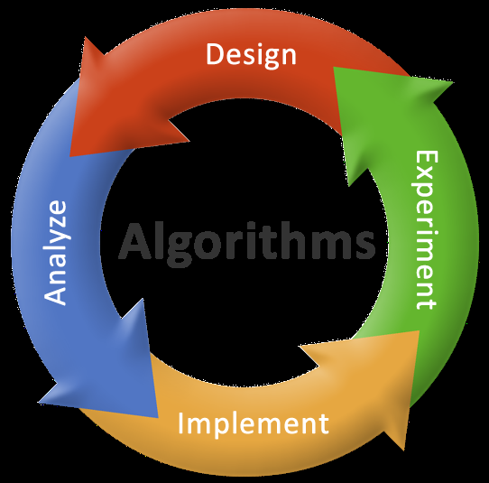
Introduction to algorithms
L3

Slide 2
Objectives
To learn and appreciate the following concepts
Introduction to algorithms
Algorithms for simple problems

Slide 3
Session outcome
At the end of session the student will be able to write
Algorithms for simple problems

Slide 4
Algorithm
A step by step procedure to solve a particular problem
Named after Arabic Mathematician Abu Jafar Mohammed Ibn Musa Al Khowarizmi
Notes:
General additional information on algorithm
In mathematics and computer science, an algorithm is a step-by-step procedure for calculations. Algorithms are used for calculation, data processing, and automated reasoning.
An algorithm is an effective method expressed as a finite list of well-defined instructions for calculating a function.
Starting from an initial state and initial input the instructions describe a computation that, when executed, proceeds through a finite number of well-defined successive states, eventually producing "output" and terminating at a final ending state.

Slide 5
Algorithmic Notations
Name of the algorithm [mandatory]
[gives a meaningful name to the algorithm based on the problem]
Start [Begin of algorithm]
Step Number [mandatory]
[indicate each individual simple task]
Explanatory comment [optional]
[gives an explanation for each step, if needed]
Termination [mandatory]
[tells the end of algorithm]
Notes:
5
5

Slide 6
Compute the area of circle
Name of the algorithm : Compute the area of a circle
Step1: Start
Step 2: Input radius
Step 3: [Compute the area]
Area ← 3.1416 * radius * radius
Step 4: [Print the Area]
Print ‘Area of a circle =‘, Area
Step 5: [End of algorithm]
Stop
Notes:
6
6

Slide 7
Interchange values of two variables
Name of the algorithm: Interchange of 2 values
Step 1: Start
Step 2: Input A,B
Step 3: temp ← A
Step 4: A←B
Step 5: B←temp
Step 6: Print ‘A=’ , A
Print ‘B=’ , B
Step 7: [End of Algorithm]
Stop
Notes:
7
7

Slide 8
Largest of 3 Numbers
Name of the algorithm: Find largest of 3 numbers
Step 1: Start
Step 2: [Read the values of A, B and C]
Read A, B, C
Step 3: [Compare A and B]
IF A>B go to step 5
Step 4: [Otherwise compare B with C]
IF B>C then
Print ‘B’ is largest’
Else
Print ‘C’ is largest’
Go to Step 6

Slide 9
Largest of 3 Numbers contd.
Step 5: [Compare A and C for largest]
IF A>C then
Print ‘A’ is largest’
Else
Print ‘C’ is largest’
Step 6: [End of the algorithm]
Stop

Slide 10
Sum and Mean of first N natural numbers
Name of the algorithm: Sum and Mean of natural numbers.
Step 1: Start
Step 2: [Read the maximum value of N]
Input N
Step 3: [Set sum equal to 0]
Sum ← 0
Step 4: [Compute the sum of all first N natural numbers]
For i=1 to N in step of 1 do
begin
Sum ← Sum + i
end
Notes:
10

Slide 11
Sum and Mean of first N natural numbers
Step 5: [Compute mean value of N natural numbers]
Mean ← Sum / N
Step 6: [Print Sum and Mean]
Print ‘Sum of N natural numbers=‘,Sum
Print ‘Mean of N natural numbers =‘,Mean
Step 7: [End of algorithm]
Stop

Slide 12
Factorial of a number
Name of the algorithm: Compute the factorial of a number
Step1: start
Step 2: Input N
Step 3: fact ←1
Step 4: For count=1 to N in step of 1 do
begin
fact←fact*count
end
Step 5: Print ‘fact of N=‘, fact
Step 6: [End of algorithm]
Stop
Notes:
12
Factorial number
In mathematics, the factorial of a non negative integer n, denoted by n!, is the product of all positive integers less than or equal to n. For example,
5! = 5 x 4 x 3 x 2 x 1 = 120.
The value of 0! is 1, according to the convention for an empty product.

Slide 13
Sum of digits of a number
Name of the algorithm: Find sum of the digits of a number
Step 1: Start
step 2: Input N
Step 3: sum←0
Step 4: While N>0
begin
rem ← N mod 10
sum← sum + rem
N←N/10 (integer)
end
Step 5: Print ‘Sum of the digits of the number=‘,sum
Step 6: Stop
Notes:
13

Slide 14
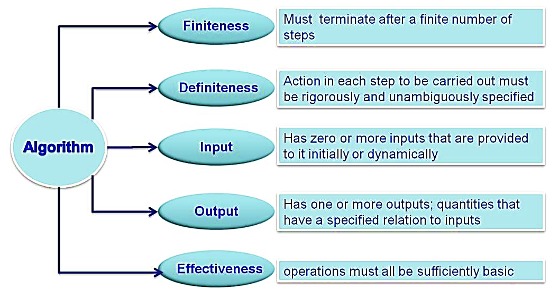
Properties of an algorithm

Slide 15
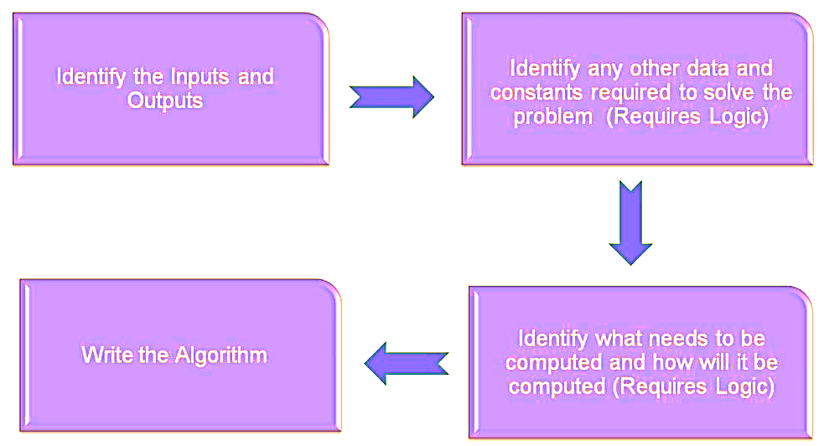
Steps to develop an algorithm

Slide 16
Summary
Introduction to algorithms
Algorithms for simple problems
Syntax
Notes & Extra problems
Do’s
Don’ts
Control Flow
Video clip
Case studies
Do it yourself

